Slide 1

Obligatory Assignment 04
Due 14 April, 15.00

Slide 2
Task 1: In this assignment you will work with NetworkX library. The details are given below:
You have to load a graph representing Zachary's Karate club using the following code:
G = nx.karate_club_graph()
This graph contains nodes representing member of the club and includes attributes named 'club' which represents which group the members belong after the seperation of the club. You will find either Mr. Hi, or Officer... it indicates two different groups.
# Task 1.1: Print out the list of nodes and edges with attributes.
# Task 1.2: You have to provide a visualization of the Karate club where the color of nodes will represent the two groups after the seperation.
# Task 1.3: Using nx.dijkstra_path() find out the shortest path from node 24 to 16. Print the list of nodes.
# Task 1.4: You have to provide a visualization of the Karate club and modify the color of the nodes by highlighting the selected nodes from the above list. Use red color to indicate the selection of the nodes.
[Tips: A jupyter notebook is available (sna.ipynb) that you can use as a starting point]

Slide 3
Task 1: The output of your program should be something similar to the following:
# Task 1.1: Expected output is similar to the following...
[(0, {'club': 'Mr. Hi'}), (1, {'club': 'Mr. Hi'}), (2, {'club': 'Mr. Hi'}), (3, {'club': 'Mr. Hi'}), (4, {'club': 'Mr. Hi'}), (5, {'club': 'Mr. Hi'}), (6, {'club': 'Mr. Hi'}), (7, {'club': 'Mr. Hi'}), (8, {'club': 'Mr. Hi'}), …......)] [(0, 1, {}), (0, 2, {}), (0, 3, {}), (0, 4, {}), (0, 5, {}), (0, 6, {}), (0, 7, {}), (0, 8, {}), (0, 10, {}), (0, 11, {}), (0, 12, {}), (0, 13, {}), (0, 17, {}), (0, 19, {}), (0, 21, {}), (0, 31, {}), (1, 2, {}), (1, 3, {}), (1, 7, {}), (1, 13, {}), (1, 17, {}), (1, 19, {}), (1, 21, {}), (1, 30, {}), (2, 3, {}), (2, 7, {}), (2, 8, {}), (2, 9, {}), (2, 13, {}), (2, 27, {}), (2, 28, {}), …......]

Slide 4
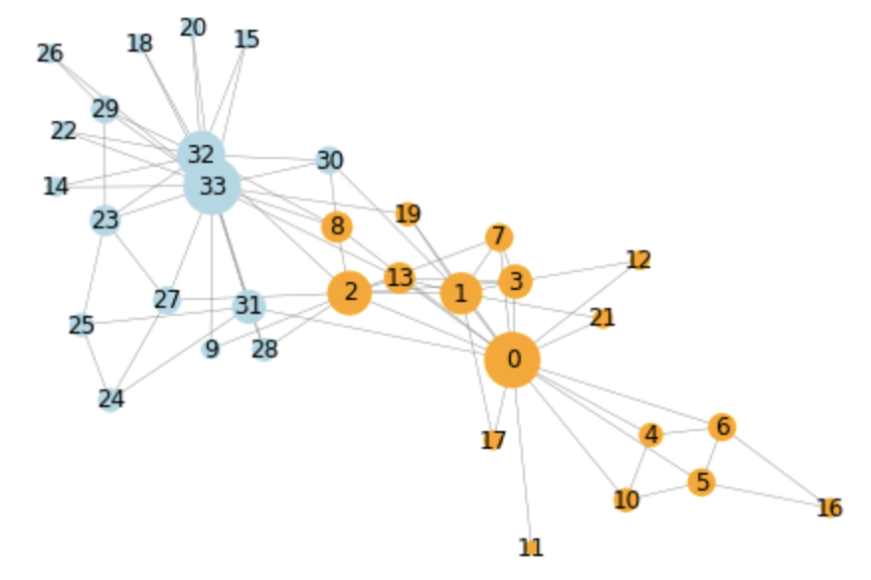
Task 1: The output of your program should be something similar to the following:
# Task 1.2: Expected output:

Slide 5
Task 1: The output of your program should be something similar to the following:
# Task 1.3: Expected output is a list of integer numbers.
# Task 1.4: Expected output is similar to this graph but the selected nodes from Task 1.3, need to be highlighted with red color
24
16

Slide 6
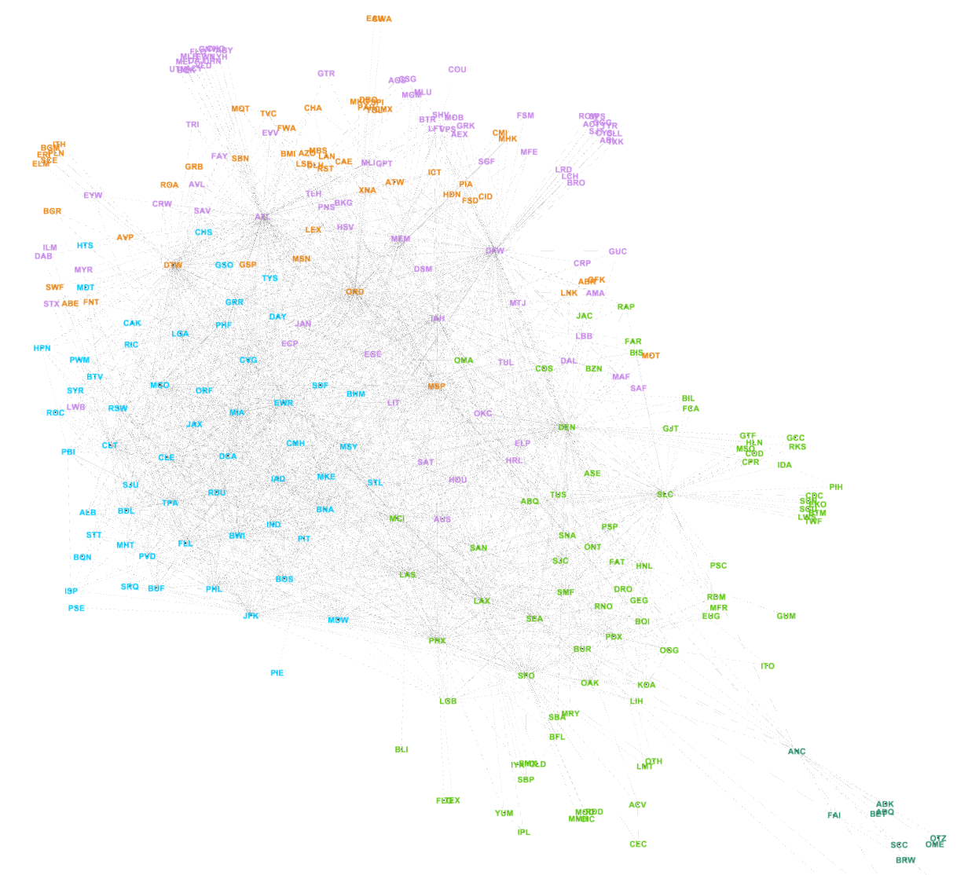
Task 2: In this assignment you will work with Gephi. The details are given below:
You will apply network analysis over an airline's dataset from https://www.kaggle.com/datasets/jimschacko/airlines-dataset-to-predict-a-delay
The dataset contains information about many flights (539383 instances) along with the airports they operate.
In this assignment you will be using Gephi to import the file and produce an analysis results.
While importing the dataset in Gephi, you will consider importing 'AirportFrom' , 'AirportTo' information. (You may pre-process the file by keeping only AirportFrom and AirportTo columns in the file)
Import the graph in Gephi as directed graph.
You should choose a merge strategy to ignore parallel edges.
Manipulate the size of the nodes based on their 'Degree'
Change the color of the nodes based on modularity.
Fix the layout to make the graph better presentable.
Display the code of the airports in the graph.
This figure shows a sample output

Slide 7
How to hand over the assignment?
You have to submit 2 files that includes solution for tasks 1 and 2.
Task1->
File1: Containing python program (You can deliver jupyter notebook file with .ipynb extention)
Task2 ->
File2: A pdf file exported from Gephi. The pdf contains the output of your network visualization.
It is very important that your program should not have any syntax error at the time of submission.
Note:: Do not delete the projects from your computer until your assignment is approved. Seminar leader will contact you if they need more information about your projects. For example, you may be asked to fix your program if the program is not behaving as it should or the output needs to be fixed.

